Slide 1

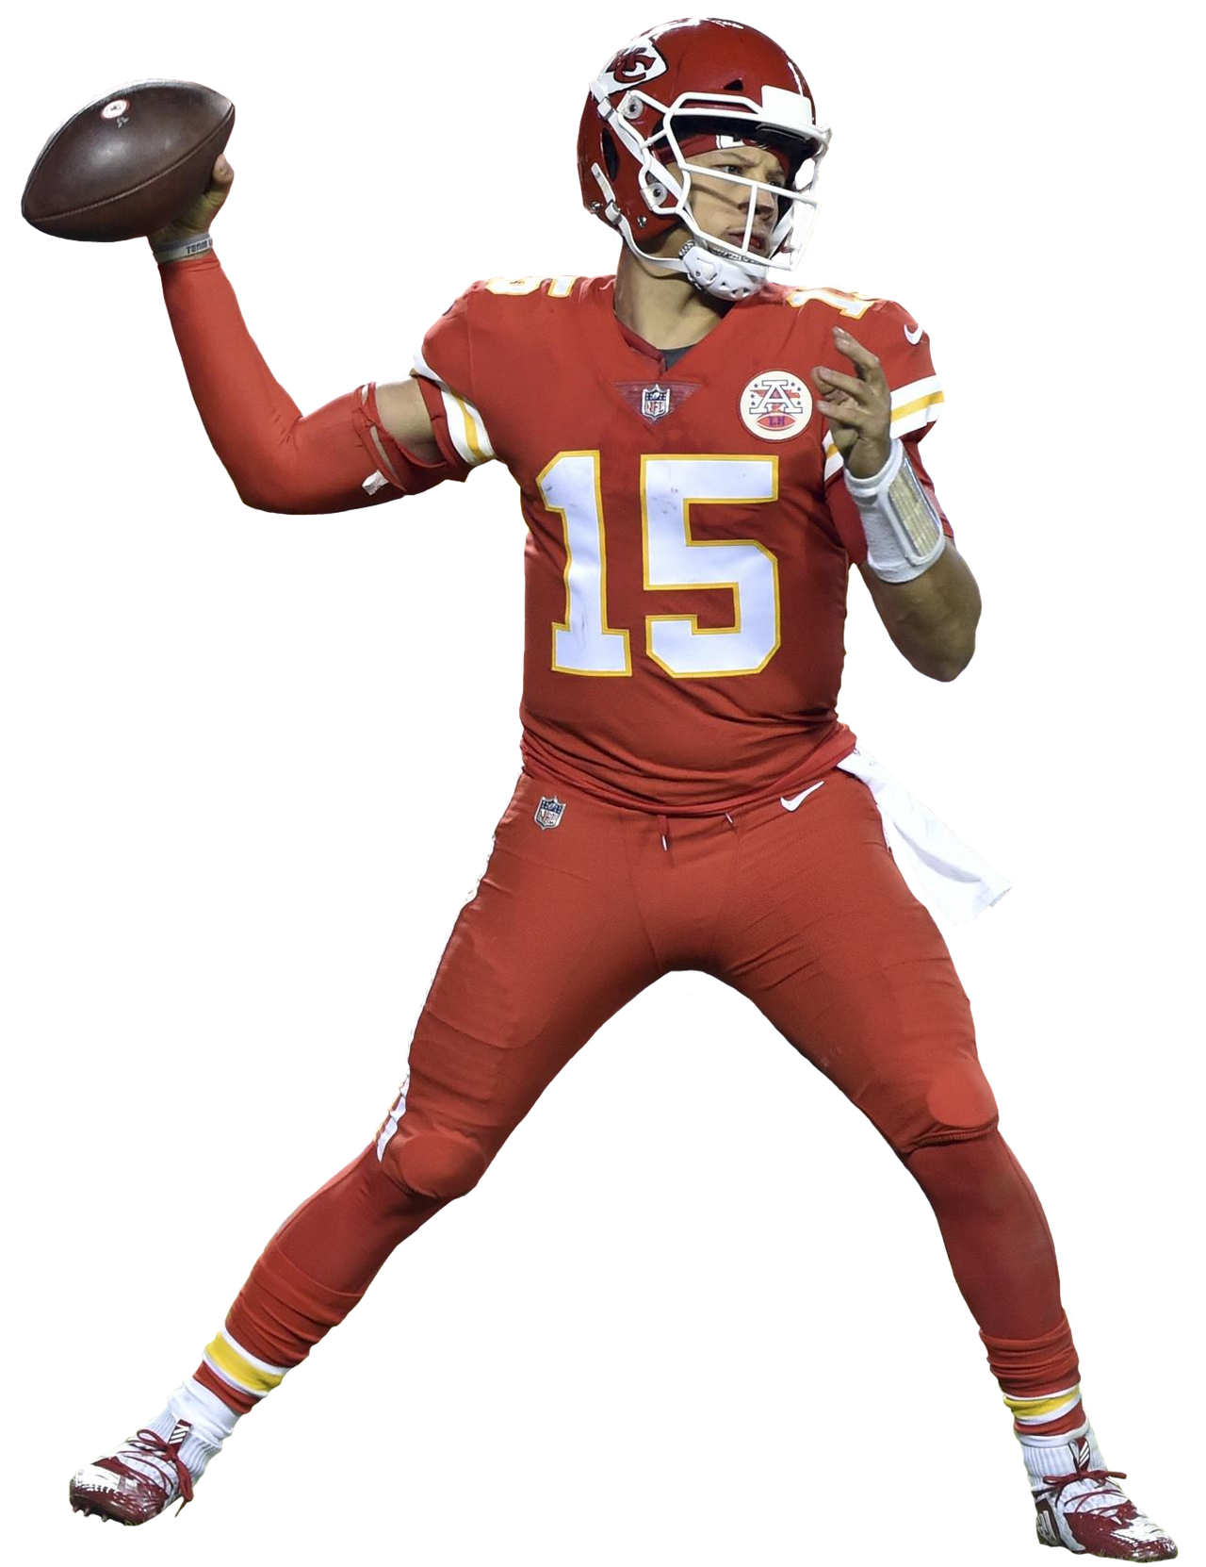
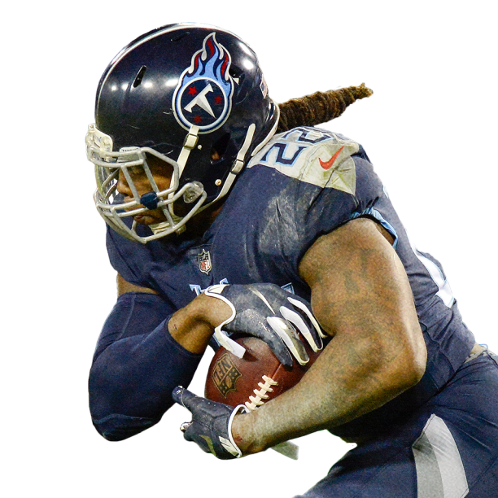
Football Data Analysis Model
By Jeremy Shiu, Krithik Jatavallabhula, Stephen Fujiwara, Kiel Messinger, and Luke Shen
Notes:
Jeremy

Slide 2
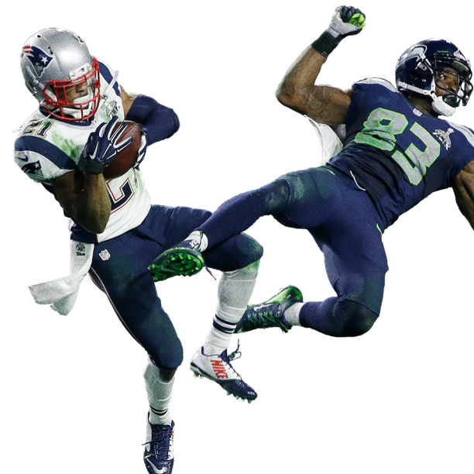
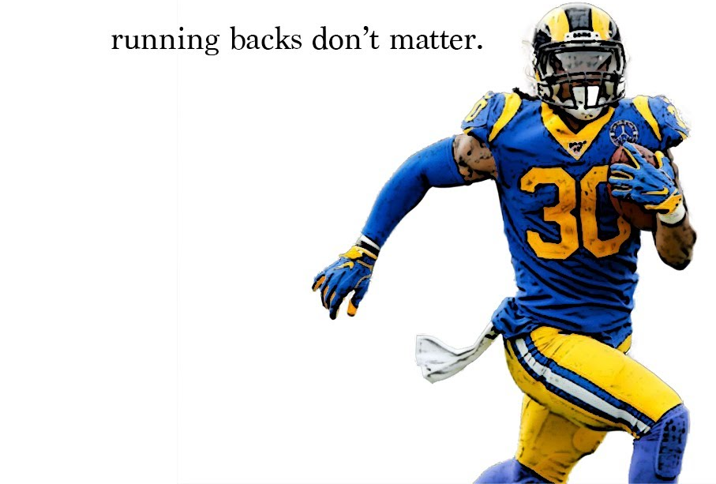
Project Purpose
The objective of this study is to analyze how different aspects of a team's performance affect their wins in a season using a predictive model constructed from various football statistics.
- Teams have to work around salary cap, draft pick, and roster space limitations.
- What positions are most valuable?
- What offensive/defensive philosophies work best?
Our model will help answer these questions.
Notes:
Jeremy

Slide 3
Model Variables
Wins: The amount of wins the given team had in the given year (whole # 0 to 16)
The following variables are not raw numbers; rather, they are the team’s ranking in the given statistic for the year compared to the rest of the league. 1 being the best, 32 being the worst for each stat. We chose to use rankings rather than raw numbers because we are only concerned with team performance relative to the league within each individual season. Thus, we expect that each variable coefficient will be negative; lower rankings in each statistic indicates poorer performance, which should lead to less wins.
RYPA: Average yards gained per rushing attempt YPPA: Average yards gained per passing attempt T.O._Margin: The net turnover margin (turnovers forced - turnovers committed) Oppo.RYPA: Average yards allowed per opponent rushing attempt Oppo.YPPA: Average yards allowed per opponent passing attempt
Notes:
Our response variable was team wins for the given season, since winning is what football is all about. The predictor variables we chose were rush yards per attempt and pass yards per attempt on offense, net turnover margin, and rush yards per attempt and pass yards per attempt allowed on defense. For each of the predictors, we chose to use the team’s ranking amongst the 32 nfl teams for the given season, with 1 being the best in the stat, and 32 being the worst. This is because we are only concerned with relative performance within a single season.

Slide 4

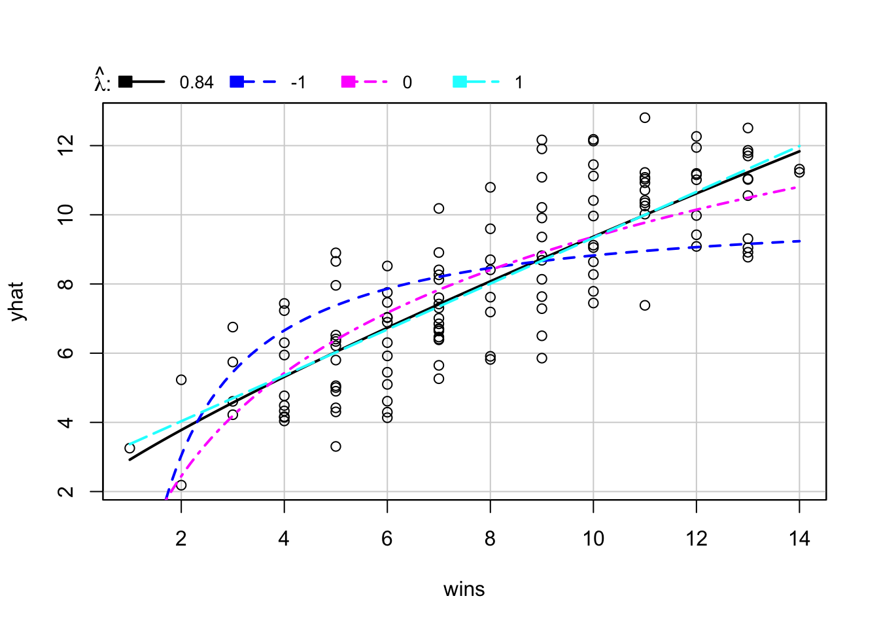
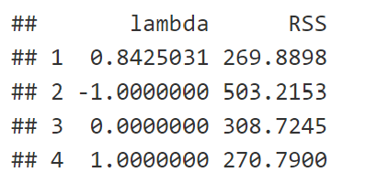
Determining the Best Model
Power Transformation:
The untransformed model fit well, but after viewing the results from an inverse response plot, we ended up applying a power transformation to the response variable.
Inverse Response Plot Results:
Notes:
Stephen

Slide 5
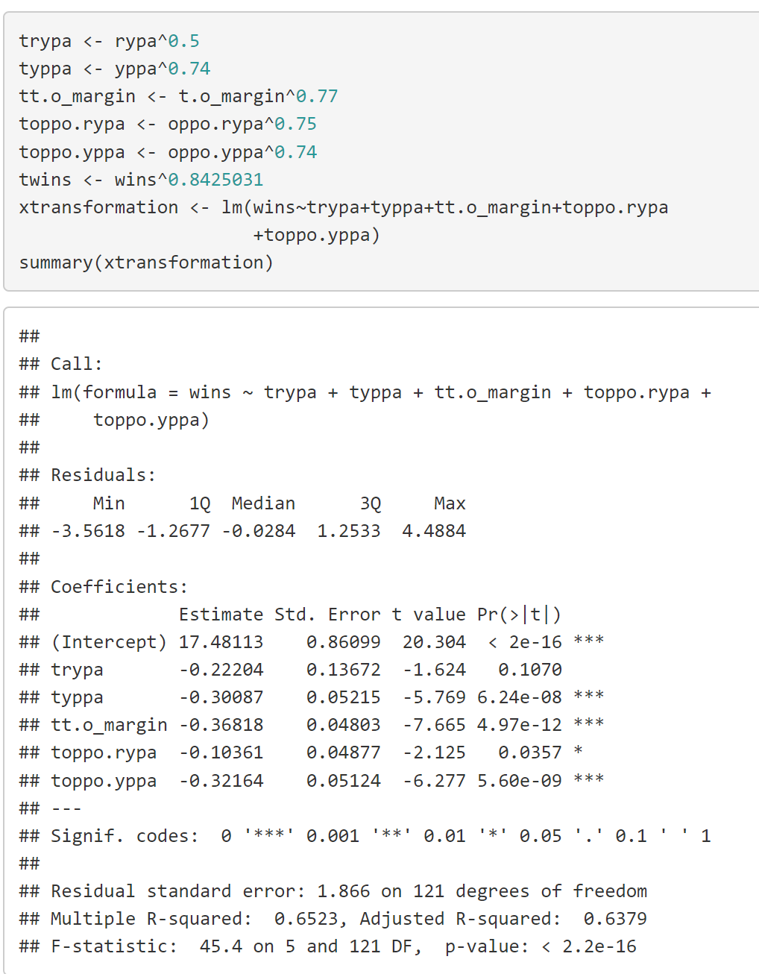
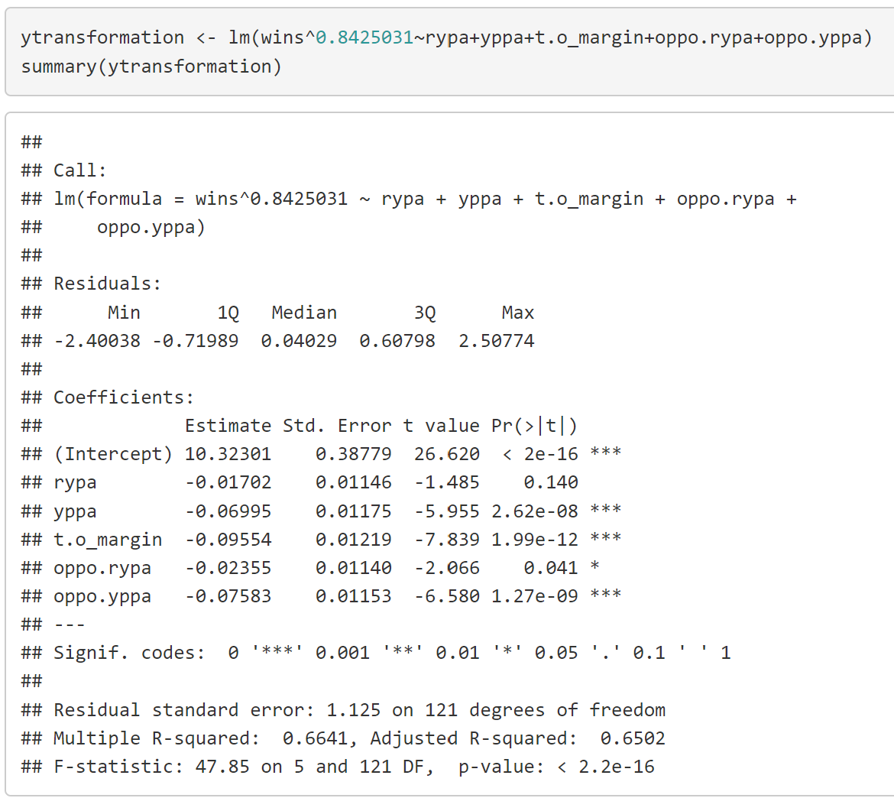
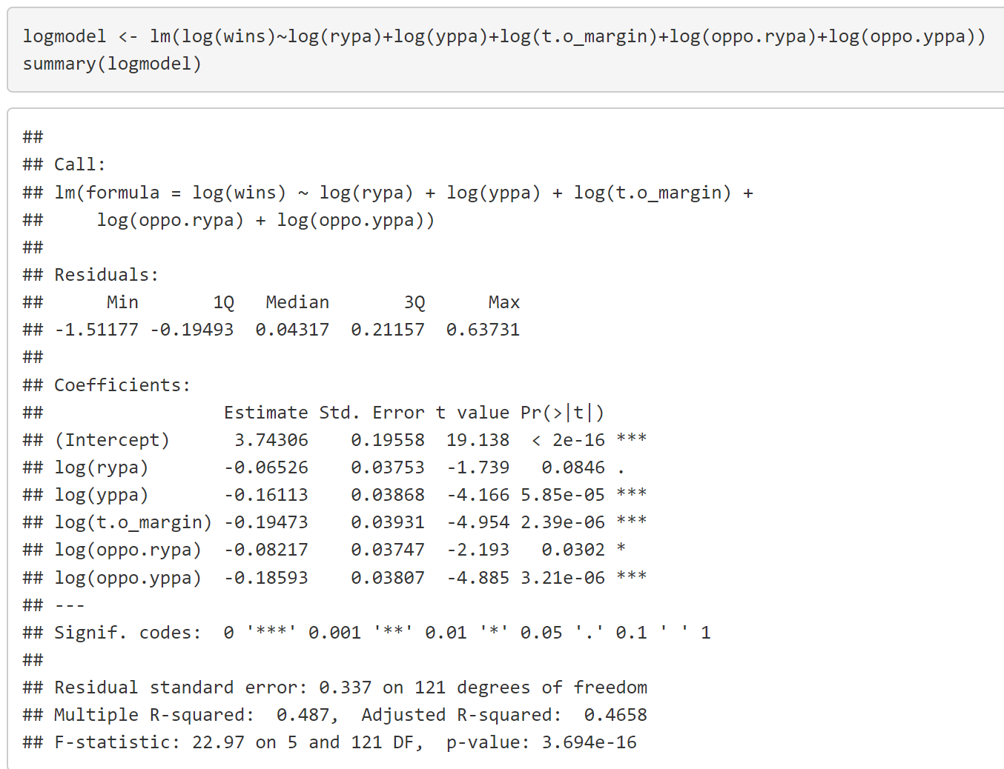
Determining the Best Model (cont.)
Out of all transformed models, the model with the power transformation applied to the response variable did the best, based on R². (R output)
Notes:
Stephen

Slide 6

Determining the Best Model (post-transformation.)
Variable (Model) Selection
Forward / Backward AIC:
Both forward and backward stepwise regression using AIC resulted in:
Forward / Backward BIC:
Both forward and backward stepwise regression using BIC resulted in:
Notes:
Stephen

Slide 7
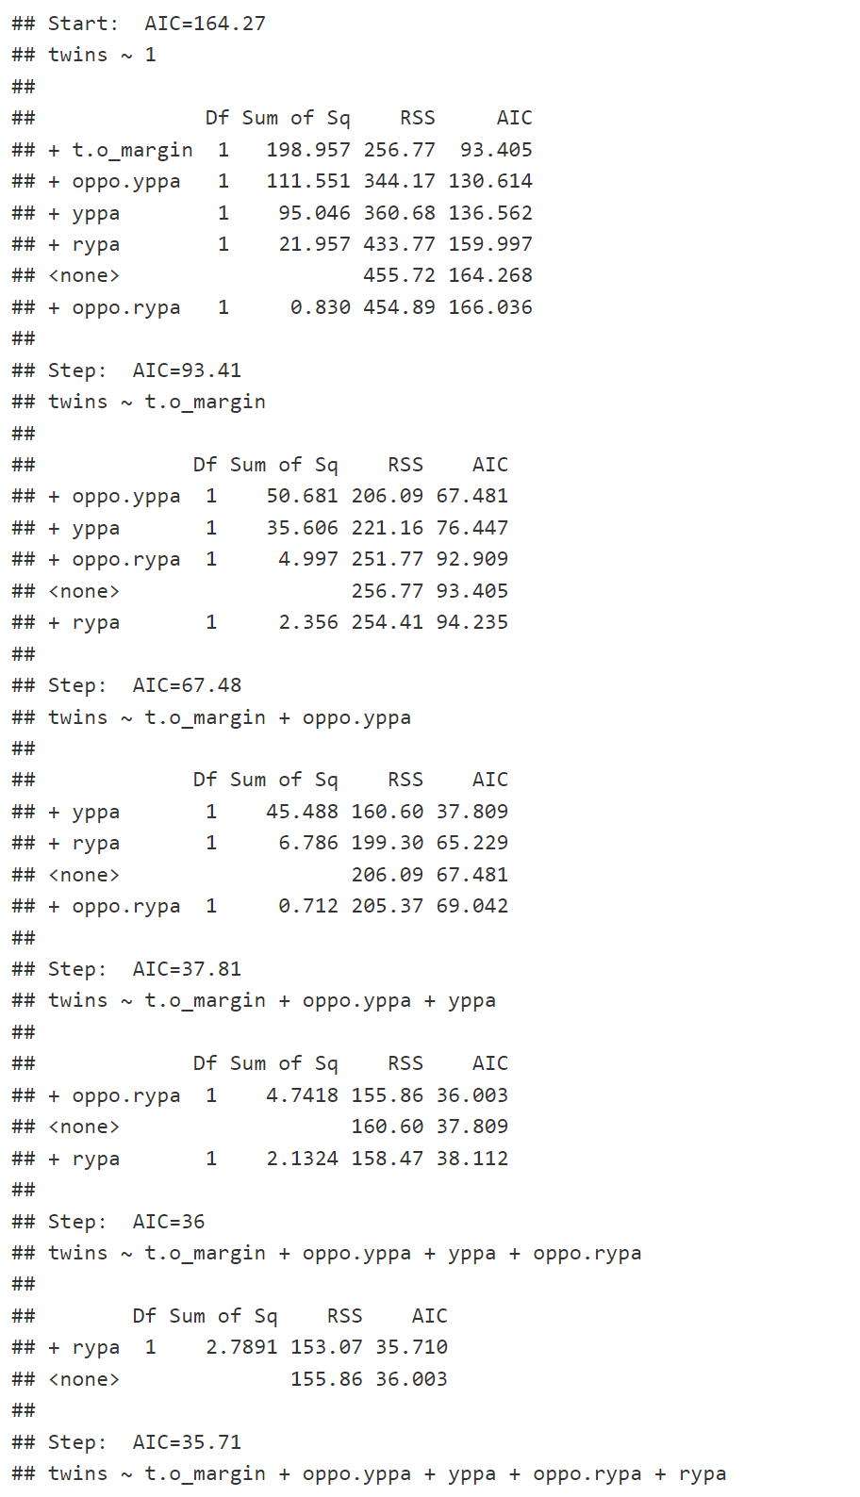
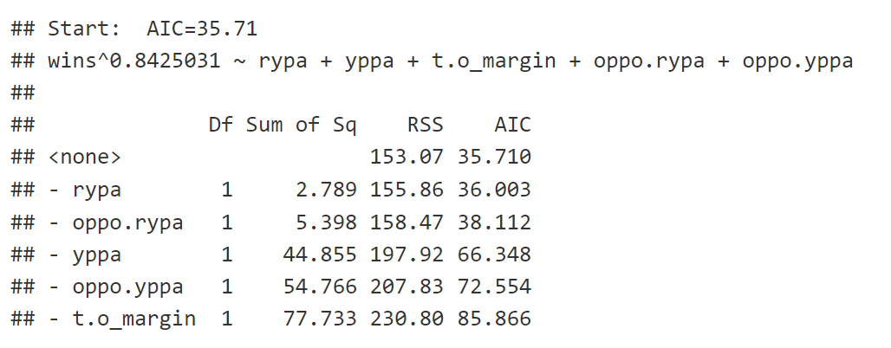
Forward / Backward AIC Results
Forward AIC:
Backward AIC:
Notes:
Stephen

Slide 8
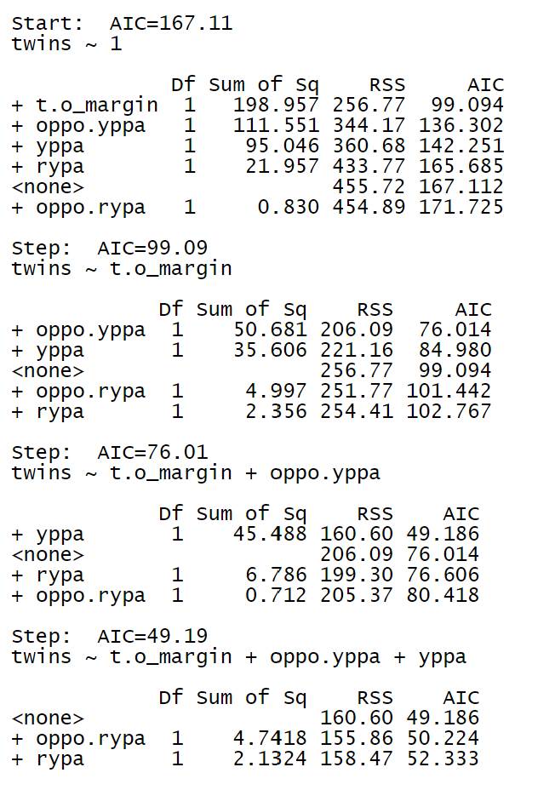
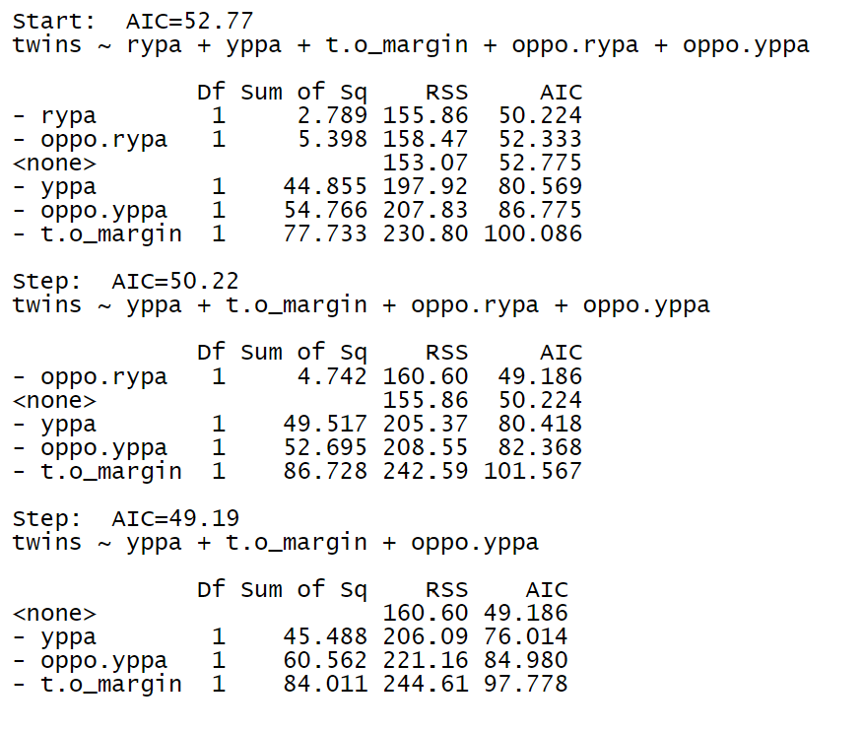
Forward / Backward BIC Results
Forward BIC:
Backward BIC:
Notes:
Stephen

Slide 9
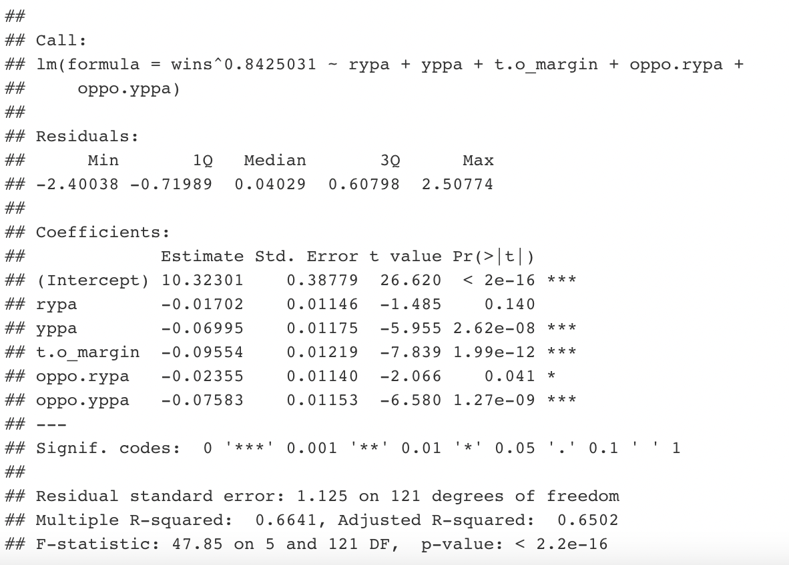
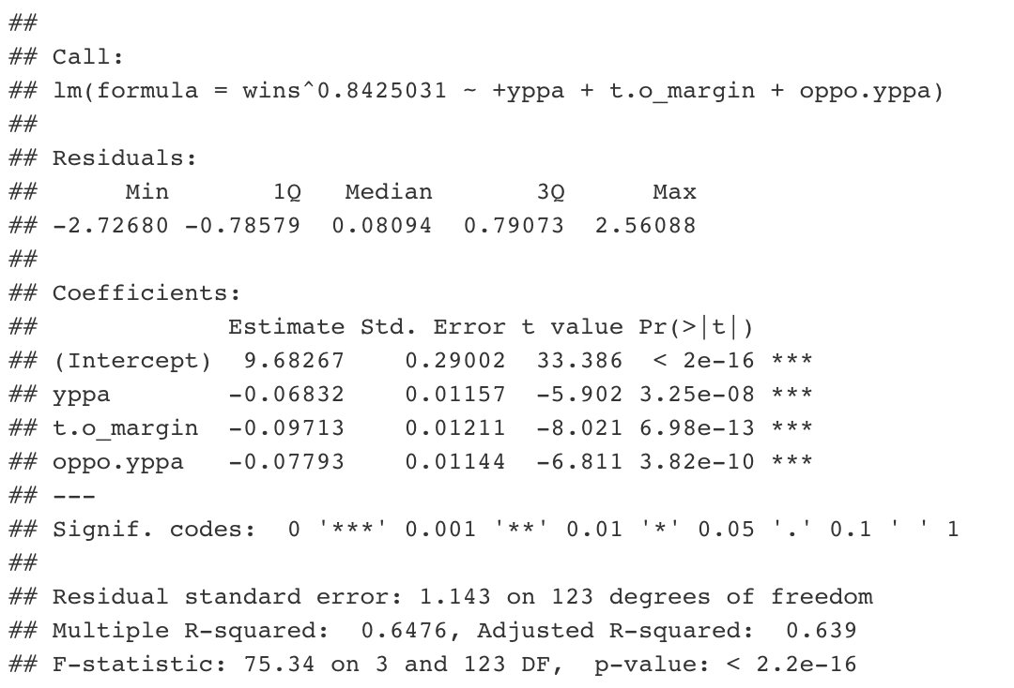
Adjusted R² (3 variable vs. 5 variable model)
The R²_{adj} of the full model is slightly greater than of the reduced model, but there is one caveat.
In the full model (all predictors), RYPA is not significant as a predictor and OPPO.RYPA is very close to not being significant as well.
Full Model
Reduced Model
Notes:
Krithik

Slide 10
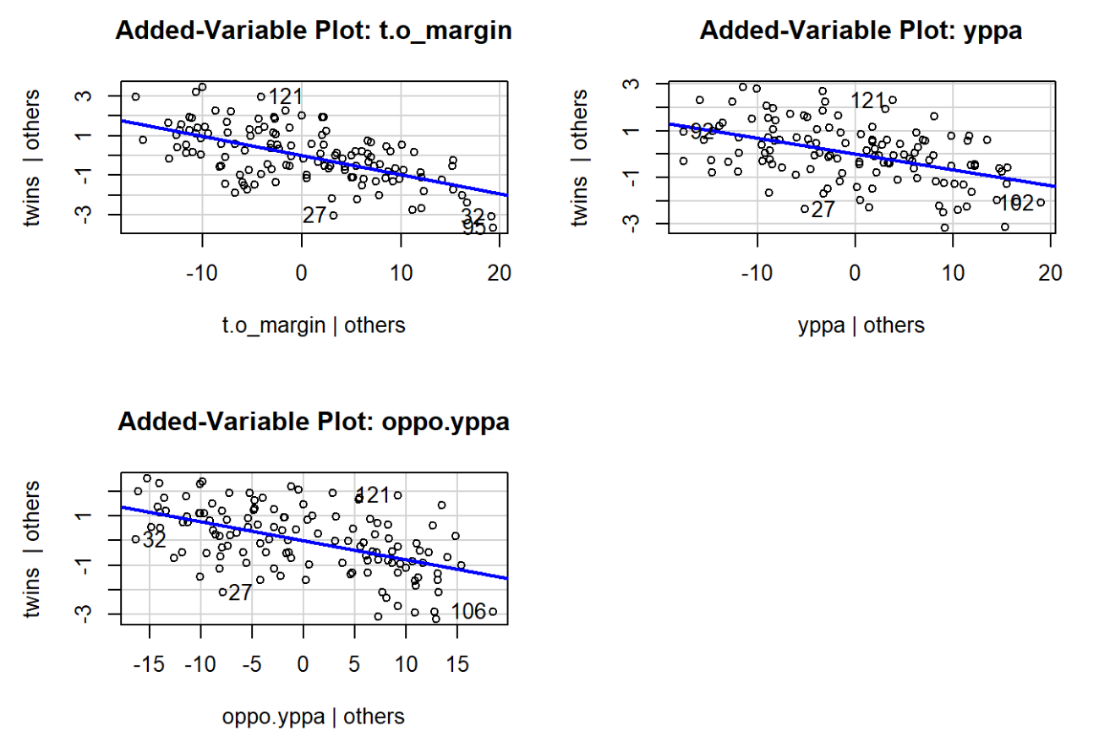
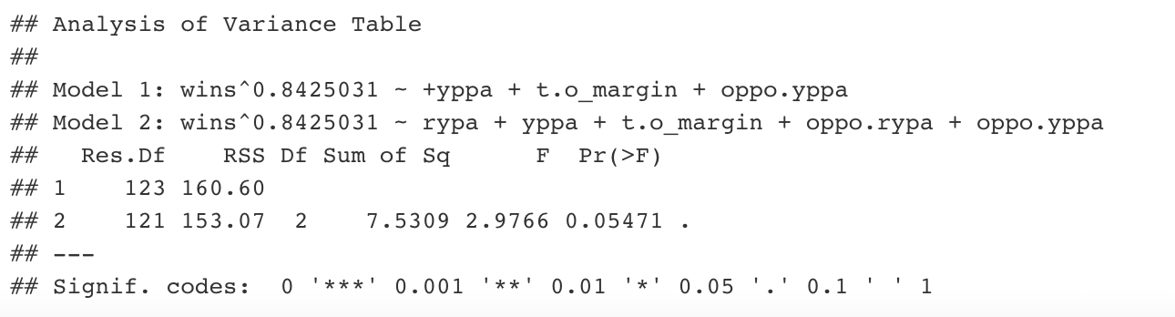

Partial F-Test, Added Variable Plots, and VIF
From a partial F-test (α = 0.05), we fail to reject the null (reduced) model as the appropriate model, although by a small margin.
All predictor variables in the reduced model have a strong “pure effect” on their own. (AV Plots)
No predictor variables in the reduced model are affected significantly by multicollinearity, and so their impacts are accurately estimated. (VIF)
Notes:
Krithik

Slide 11
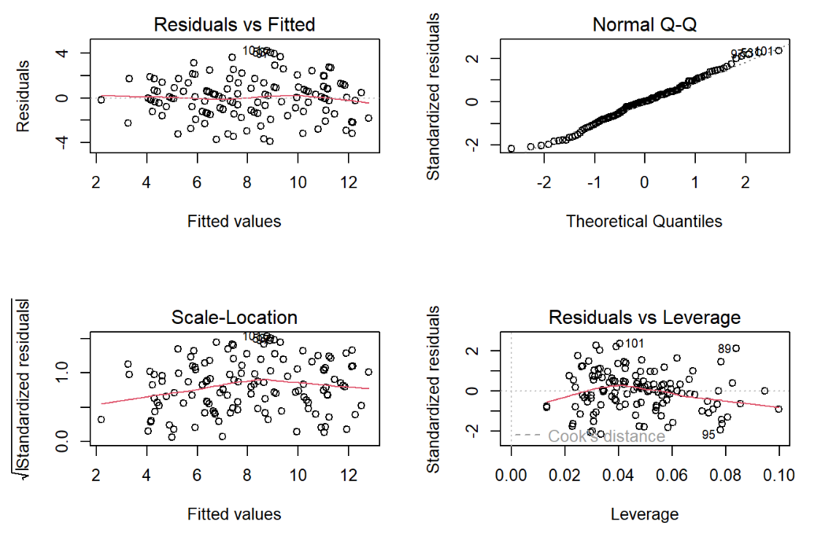
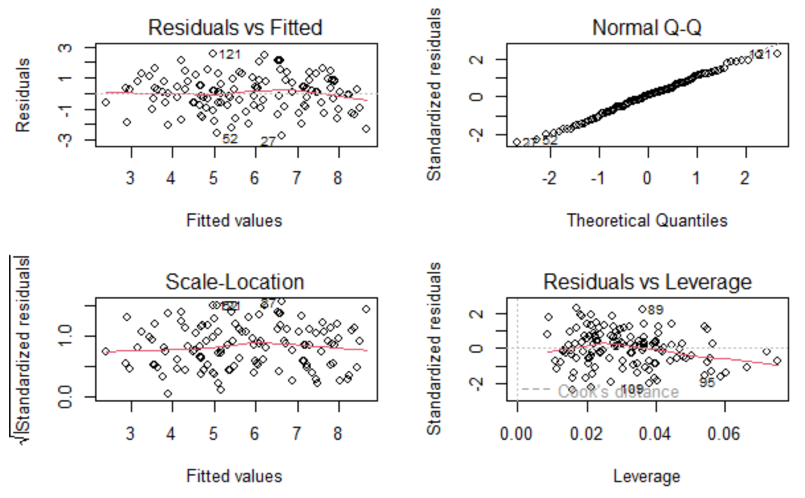
Final Model Assessment: Diagnostic Tools
Original model (untransformed):
Final Model:
Notes:
Krithik

Slide 12
Final Model Decision
There was evidence for both keeping and removing the rushing variables from the model, but in the end, we decided to choose the model with significant
Argument for full model | Conflicting Evidence | Argument for reduced model
AIC test chose the full model | R²_{adj} was slightly but not significantly higher for full model | RYPA not significant in slope hypothesis test
Teams rush over 40% of the time still so it is a large proportion of the game | Added variable plots for rushing variables showed some trend but not clear necessity | Partial F-Test did not reject null hypothesis of reduced model
No multicollinearity risk so additional variables would not hurt (Low VIF values) | Diagnostic Plots are pretty much the same for both options | BIC chose reduced model
Notes:
Kiel

Slide 13
Results of The Model
Final Model:
–> Wins = (9.683 - .068(YPPA) - .097(T.O._Margin) - .078(OPPO.YPPA))^{1.183}
R²: The R² was .6476, indicating that ~64% of the variance in wins is explained by the model. Some other factors could be the rushing efficiency (was worth about 1-2%) conversion/success rate on 3rd or 4th down and in the red zone (touchdowns vs. field goals), and average margin of loss/victory (some teams might run up their score in a blowout).
Notes:
Kiel

Slide 14
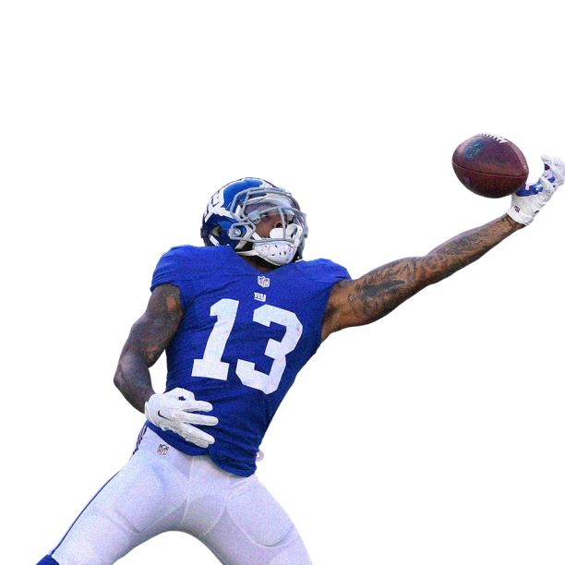
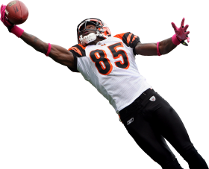
Slope Interpretation and Model Predictions
An improvement in yards per pass attempt by 10 ranking spots (prev. ranking - 10) would increase wins by .68^{1.183} = .63 wins.
An improvement in turnover margin by 10 ranking spots (prev. ranking - 10) would increase wins by .97^1.183 = .96 wins.
An improvement in opponents yards per pass attempt by 10 ranking spots (prev. ranking - 10) would increase wins by .78^{1.183} = .75 wins.
Notes:
Kiel

Slide 15
Implications to NFL Strategy
Passing > Running, T.O.’s Reign Supreme: Strong rushing efficiency on both offense and defense is not a prerequisite for being a winning team. Passing efficiency on both offense and defense are far more significant predictors for wins. And, as we expected, turnover margin is the strongest predictor of wins, according to our model.
Potential Explanations: Why is passing efficiency so much more important than rushing efficiency in the modern NFL? Here are a few potential reasons why: 1. An offense that is only strong in passing offense is more difficult to stop than that of rushing. 2. Passing is more conducive to explosive plays than rushing. 3. Comeback victories are generated by passing the ball, not running it (rushing attempts quickly drains the game clock).
Final Thoughts: Conventional NFL wisdom says that a team needs a balanced rushing and passing attack to dominate. However it appears that trends are shifting. Rushing efficiency still matters - perhaps, just less than we may have thought. Anecdotally and intuitively, these conclusions make sense; the NFL continues shifting to a more pass-centric league and each of the last five Super Bowl winners have been led by star quarterbacks and stout defenses with relatively cheap running backs.
Notes:
Luke - The most insightful implication for real life nfl strategy is that passing offense and defense and winning, as well as winning the turnover margin, are far more important for winning than rushing offense and defense. Intuitively, these conclusions make sense, as each of the last 5 super bowl winners

